Slide 1
Mizuho Dashboard
by PQM InnoTeam
3 Jun 2020

Slide 2
Objective
To bring Dashboard culture to Mizuho
using tools such as Tableau, Qlik Sense, Microsoft BI (business intelligence) which are popular analytical dashboard tools
business users and non-IT savvy staff can easily create the dashboards

Slide 3
What is a Dashboard
A consolidated display of many data and related information in a single place
We use it to compare and monitor a variety of data simultaneously

Slide 4
Why do we need a Dashboard
Current method to explore data and find insights is using Excel, etc
excelfile
need to know where data is to find insights
process of drilling down into data is less flexible, making it harder to explore information
In Dashboard, we use Data visualization
link
freely explore data without knowing the answer you want ahead of time
able to spot correlations and trends, and then dig down to understand what caused them to happen, rather than the other way around

Slide 5
Dashboard Tool - Tableau (1)
What's Tableau
“Grand master” of data visualization software
over 60,000 user accounts across a multitude of industries
interactive interface with simple drag-and-drop functionality speeds up and simplifies the creation process
can easily handle large, fast-changing datasets
integrates smoothly with various technologies e.g. Hadoop, AWS, MySQL, SAP and Teradata

Slide 6
Dashboard Tool - Tableau (2)
Tableau is not new to Mizuho
Currently we have 22 desktop licences (9 desktop, 13 creator) managed by different departments and having different expiry dates
AOOP/AOAD 7 (Desktop-6 Creator-1)
AOTD 3 (Desktop-3)
RMD 3 (Creator-3)
MRD 4 (Creator-4)
AIOD 5 (Creator-5)

Slide 7
Next Steps (1)
1. Convert Tableau desktop to server licence
This is a collaboration between
PQM - Guru, Siew Lan, Jeena, Shawn
AIOD - Okuno san and Bryan with support from Fujita san
- goal is to deploy Tableau Server to enable collaboration and empower more users to gain insights from the dashboard while ensuring data governance
- central environment
- using Active Directory to access i.e. login using own Windows ID
- Using web browser, no installation required

Slide 8

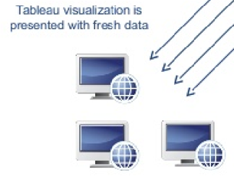
Next Steps (2)
Tableau Desktop Flow (As-is)
send workbook
via email

Slide 9
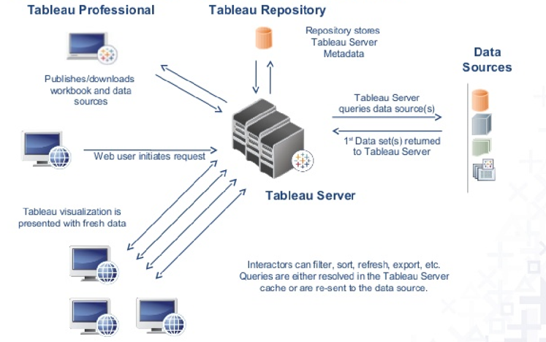
Next Steps (3)
Tableau
Server
Flow
(To-be)

Slide 10
Next Steps (4)
2. Server Licence Type
1. Tableau Creator - to create and publish data sources 2. Tableau Viewer - to view and interact with trusted content in the server - gives users access to the right data within a governed platform without the exporting and emailing that puts the security of the data at risk 3. Tableau Explorer - can create new workbook using data sources published to Tableau Server - but cannot create new data sources 4. Tableau Server - allows users to save workbooks securely - to centrally manage collaboration, security and performance

Slide 11
Next Steps (5)
3. Cost (US$16,346 till 12 May 2021 ; thereafter US$36,200/yr
→ excluding additional creator licence)
S/N | Item | Cost
1 | Hardware | US$0 - AIOD will prepare server by using existing hardware for (Production and DR server). Dev server to be confirmed.
2 | Software - convert desktop to server licence | US$0
3 | Software - align to same expiry date | US$3,879 (align to 12 May 2021) US$17,600/yr (after 12 May 2021) Note: Same annual cost when we renew desktop licences Additionally, InnoTeam to decide on how many new licences to purchase starting 1 Aug 2020 to 12 May 2021
4 | Software - viewer licence | US$12,467 for 100 users (to 12 May 2021) US$14,400/yr for 100 users (after 12 May 2021)
5 | Software - explorer licence | US$4,200/yr for 10 users → not necessary for now

Slide 12
Next Steps (6)
Training
To be conducted by PQM and/or vendor
for users who need to create new workbooks, dashboards
for users who need to view and interact with published workbooks, dashboards
Updates on Servers from AIOD
Production and DR → not decided yet
Development → likely standalone

Slide 13
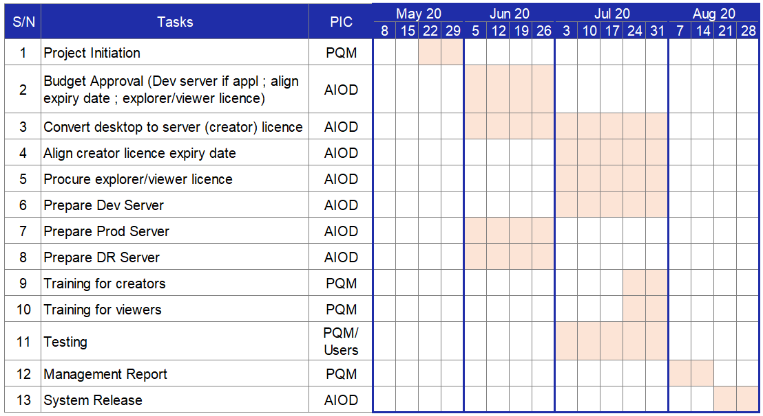
Schedule - Tentative

Slide 14
Thank You

